Slide 1
Lost and found management system
Olympus Forge
Zain Tahir
Awwab aamir
Abdullah Waheed

Slide 2
Agenda
Introduction of System
Architecture
Project planner
User stories
Testing
Conclusion

Slide 3
Our system
Purpose:
Digitally manage lost and found item reporting.
Goals:
Streamline reporting and claiming process
Ensure secure tracking and verification
Improve item matching via search and notifications

Slide 4
Architecture

Slide 5
Architecture Style
Client: Component-Based (React Components)
Server: Layered (Routes → Controllers → Services → Models)
RESTful Communication (HTTP API between frontend & backend)
Repository Pattern (Mongoose for MongoDB Access)

Slide 6
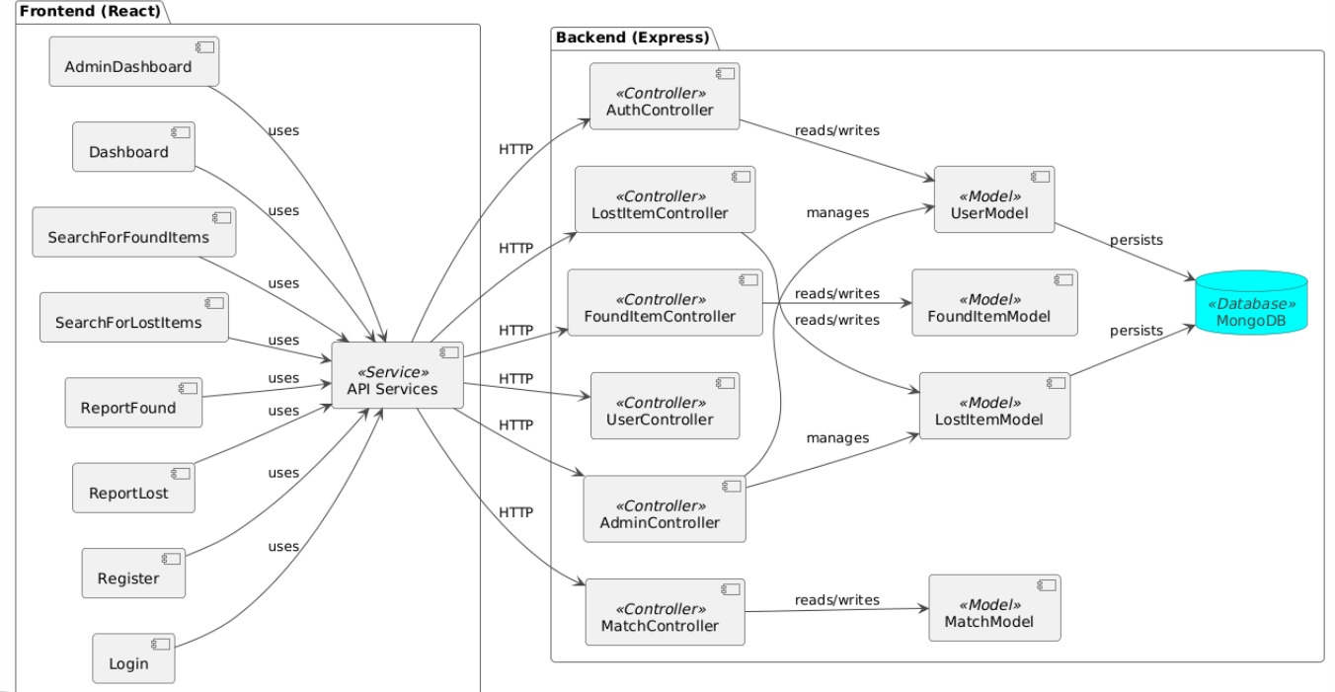
Component diagram

Slide 8

Project Planner

Slide 9
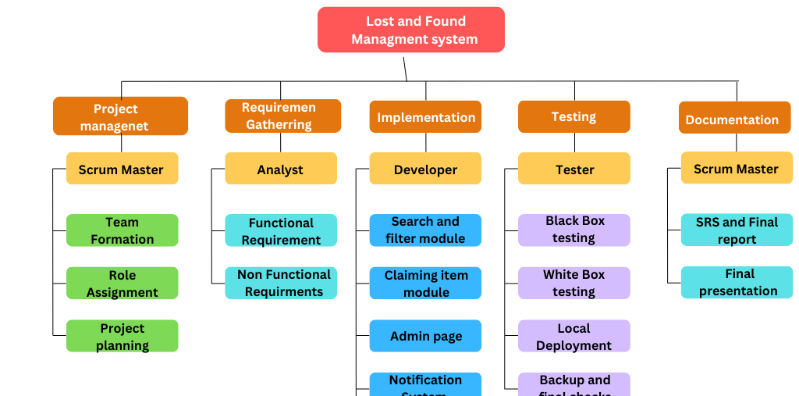
Work breakdown Structure

Slide 10
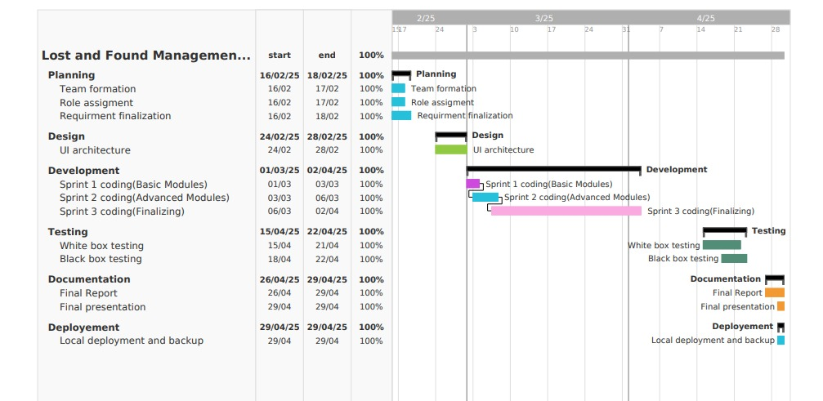
Gnatt chart

Slide 11
Sprint Planning
Sprint 1: Basic Modules - Registration, Lost Item Reporting
Sprint 2: Advanced Modules - Found Reporting, Claims, Search
Sprint 3: Testing, Notifications, Admin Panel, Deployment

Slide 12
User Stories

Slide 13
1. Report a Lost Item (Abdullah)
• User Role: User
• Goal: Report a lost item by providing relevant details.
• Reason: Enables users to submit lost item reports, increasing the chances of retrieval.
• Pre-conditions: User must be logged in.
• Post-conditions: The lost item report is stored in the database and confirmation is sent to the user.
2. Report a Found Item (Abdullah)
• User Role: User
• Goal: Report an item found with necessary details.
• Reason: Allows users to report found items, helping lost items be reclaimed by their rightful owners.
• Pre-conditions: User must be logged in.
• Post-conditions: The found item report is saved in the database, and confirmation is sent to the user.

Slide 14
3. Search for Lost Items (Abdullah)
• User Role: User
• Goal: Search for lost items using filters like category, location, and date.
• Reason: Helps users find lost items efficiently.
• Pre-conditions: The user must have access to the search page.
• Post-conditions: A list of matching lost items is displayed.
4.Claim a Found Item (Abdullah)
• User Role: User
• Goal: Submit a claim request for a found item by verifying ownership.
• Reason: Ensures that only rightful owners retrieve lost items.
• Pre-conditions: A matching found item must be listed.
• Post-conditions: The claim request is submitted for verification.

Slide 15
NAVIGATING Q&A SESSIONS
Know your material in advance
Anticipate common questions
Rehearse your responses
Maintaining composure during the Q&A session is essential for projecting confidence and authority. Consider the following tips for staying composed:
Stay calm
Actively listen
Pause and reflect
Maintain eye contact

Slide 16
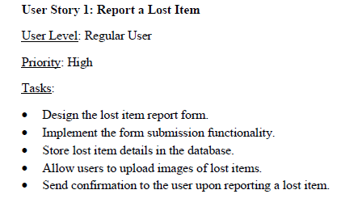
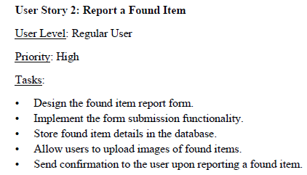
Product Backlog

Slide 17
TESTING

Slide 20
DYNAMIC DELIVERY
METRIC | MEASUREMENT | TARGET | ACTUAL
Audience attendance | # of attendees | 150 | 120
Engagement duration | Minutes | 60 | 75
Q&A interaction | # of questions | 10 | 15
Positive feedback | Percentage (%) | 90 | 95
Rate of information retention | Percentage (%) | 80 | 85
Learn to infuse energy into your delivery to leave a lasting impression
One of the goals of effective communication is to motivate your audience

Slide 21
FINAL TIPS & TAKEAWAYS
Consistent rehearsal
Strengthen your familiarity
Refine delivery style
Pacing, tone, and emphasis
Timing and transitions
Aim for seamless, professional delivery
Practice audience
Enlist colleagues to listen & provide feedback
Seek feedback
Reflect on performance
Explore new techniques
Set personal goals
Iterate and adapt

Slide 22
SPEAKING ENGAGEMENT METRICS
IMPACT FACTOR | MEASUREMENT | TARGET | ACHIEVED
Audience interaction | Percentage (%) | 85 | 88
Knowledge retention | Percentage (%) | 75 | 80
Post-presentation surveys | Average rating | 4.2 | 4.5
Referral rate | Percentage (%) | 10 | 12
Collaboration opportunities | # of opportunities | 8 | 10

Slide 23
THANK YOU
Mirjam Nilsson​
206-555-0146
mirjam@contoso.com
www.contoso.com

